Slide 1
Database Development Life Cycle
Brief overview

Slide 2
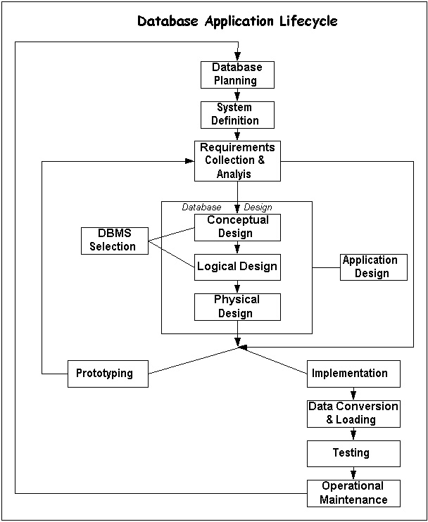
Overview of the DbDLC

Slide 3

Database Application Lifecycle
Database Planning
Focus here is on management activities
Activities include:
  Work to be done
  Resources available
  TORs
  “Surely we can spend a few minutes before rushing off to spend our money or write programs. Isn’t that extra hesitation the essence of design” – Gerald Weinberg
Notes:
Designing the project and the needs of the project – assigning managerial/supervisor duties, identifying programmers needed and those available, determining the time-frame, etc

Slide 4

Database Application Lifecycle
System Definition
Scope
Parameters
Application areas
User groups
Notes:
Are we going to go for the full scope or start small. Eg, only efa indicators or more? One goal or more?
Who are the users needing this information?

Slide 5
Information Needs/Requirements Analysis
Goal: to communicate information in ways that are relevant to the recipient group
A process of:
  Discovery
  Refinement
  Modelling
  Specifications
Notes:
Once we have identified the different levels of users who will need this data. Tailor made for each level of education system.
Eg parents, teachers want school specific data – examination results, drop while district education officers, provincial want a different level eg, deployment of resources,
Performance of educational projects and programmes
Keep going back to the user as much as possible, and redefining as new requirements always come up. Better to get as much requirements as possible before designing the system.
This is the part where you as EFA Coordinators have a large role to play. What kind of data is usually asked of me and what do I want the system to do for me?

Slide 6
Requirements Discovery Methods
Collecting facts from existing documentation
Research and site visits
Questionnaires
Interviews
Discovery prototyping
Notes:
How do we go about collecting requirements analysis?

Slide 7
Goals of Requirements Analysis
to determine the data requirements of the database in terms of primitive objects
to classify and describe the information about these objects
to identify and classify the relationships among the objects
to determine the types of transactions that will be executed on the database and the interactions between the data and the transactions

Slide 8
Goals of Requirements Analysis (contd)
to identify rules governing the integrity of the data
Notes:
The more accurate we can be at this stage, the better designed our database will be. And more suited to the needs of the user

Slide 9
Database design
The process of creating a design for a database that will support the enterprise’s operations and objectives

Slide 10
Database Design Framework
Determine the information requirements
Analyse the real-world objects that you want to model in the database
Determine primary key attributes
Develop a set of rules that govern how each table is accessed, populated and updated
Identify relationship between the entities
Plan database security
Notes:
The first step in the design process is to research the environment that you are trying to model. This involves interviewing prospective users and reviewing existing documents to understand the user requirements.

Slide 11
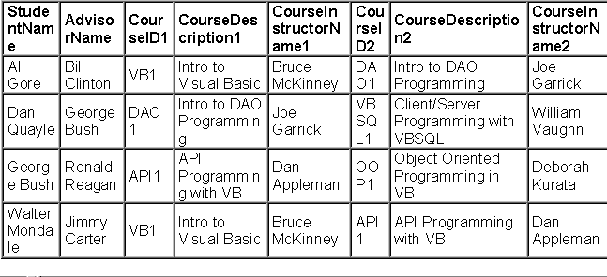
Students and courses
Notes:
This is an example of a flat file with data we want to store in the database.
If we wanted to add information about the advisor in this situation, we would have to create another flat file, and repeat the same information (name, school he works at, etc), so if something changes…
If we can somehow make the advisor’s information stand alone, yet link it somehow to the rest of the related data/……this is the concept behind relational databases

Slide 12
Identifying entities
Students
Courses
Instructors
StudentCourses
Advisors

Slide 13
Identifying attributes
What information on each entity should we know?
Students(student_id, Fname, lname, phone, advisor_id)
Advisors(Advisor_id, Advisorname, Advisorphone)
Instructors(instructor_id, Instructorname, Instructorphone)
StudentCourses(Student_id, Course_id)
Courses(Course_id, Coursedescription instructor_id)

Slide 14
Stages of Implementation
Hardware/Software Acquisition if needed
Programming
Testing (program, subsystem, system tests)
Training (lead users, train the trainer)
Conversion (in order of increasing complexity and risk)
  Parallel (old and new systems)
  Pilot (small scale, small scope)
  Phased (most critical functions first)
  Direct Cutover (with manual parallel operations)

Slide 15
Database Maintenance
Objectives: Fix “bugs” (incorrect program specs or code) in software, add enhanced functions, cycle back through SDLC phases as needed for small-scale projects
End Result: Fully Functional “Robust” System
Methods: As needed for phases above; audit the system
How to Avoid Risk: Watch changing business requirements, set priorities.

